Slide 1
PERSONAL
FINANCING
PERSONAL FINANCING REFINANCING ISSUE
Personal Financing, Sales & Marketing Division
Last updated : 07 Dec 2017

Slide 2
Contents
Background
Incident Flow
Root Cause
Affected Account
System Impact
Business Impact
Business ACTION PLAN
APPENDIX

Slide 3
Background

Slide 4
PF Refinancing Disbursement Issue
Background
On October 2017, CSU / Branch noticed irregularity on the offset amount displayed in the “Letter of Authorization to Offset Amount” against the posted Early Settlement amount in the old PF Account – and immediately raised ITH & IR to ITG.
The posted Early Settlement amount to close the Old PF Account had been computed with the enhanced formula. However the amount show in “Letter of Authorization to Offset Amount” has displayed using the Old formula.

Slide 5
PF Refinancing Disbursement Issue
Incident Flow
Old 821 Account to be Replaced with Refinancing 851 Account
Old PF Account (821)
Perform Early Settlement
to Old Account
Correct Formula has been used to capture the amount for Early settlement and has successfully posted.
Letter of Authorization
to Offset Amount
“Letter of Authorization to Offset Amount” in AS400 captured the amount based on old formula. This impact the New Disbursement Amount.
TT Net
Disbursement amount
Net disbursement amount for New 851 account was computed from the wrong Offset amount captured from “Letter of Authorization”
New PF
Refinancing Loan
(851)
Disbursement Amount had Shortfall / Over Disbursement

Slide 6
PF Refinancing Disbursement Issue
Root Cause
The main issue is due to the Early Settlement Enhancement which was done to rectify the existing rebate formula, which was one of the audit finding items.
The rebate formula has been done, however there is one program/routine during S&P Refinancing process that calculates the offset amount to close the previous PF Account that was left out during development. Thus, after promotion on the 6th of August, 2017 the module for PF Refinancing was still using the old computation, wherein the amount was usually higher than the amount produced using new formula.

Slide 7
PF Refinancing Disbursement Issue
Affected Account
Upon ITG checking, the irregularity on the offset amount has affected a total of 1,929 accounts which 1,716 was disbursed less, and 213 accounts was disbursed more than the correct amount.
Done Manual Disbursement
0.05%
1 Acct
manually
disbursed
1 account has been successfully performed manual disbursement amount of RM1,741.88
Disbursed More Amount
213 Accounts
(RM 156.36)
A total of 213 accounts affected at total RM156.36
11.04%
Disbursed Less Amount
89.04%
1,715 Accounts
RM 75,544.40
A total of 1,712 accounts affected at total RM75,544.4

Slide 8
PF Refinancing Disbursement Issue
System Impact
ITG has done an immediate fix on 16th October 2017. No additional cases recorded after the fix.
A total of 1,712 accounts are required to be perform manual disbursement due to the less amount received by the customer. 3 accounts had been Early Settlement & 1 Manual Settlement. Data rectification is required after successful manual disbursement. This is to show the rightful disbursement amount to customers’ account.

Slide 9
PF Refinancing Disbursement Issue
Business Impact
Personal Financing customers under Loan Code 851 received lesser or more amount than the rightful amount of disbursement.
These had affected the company P&L especially due to accounts which has received higher disbursement amount.

Slide 10
PF Refinancing Disbursement Issue
Business Action Plan
A Letter template has been drafted for those affected customers to inform on the shortage of the disbursement amount. Furthermore, customer are to be informed that the shortfall will be credit back to customers loan disbursement account within 7 days (from the date of letter).
Manual disbursement is required to those accounts that has been disbursed less.
Notify
customer
with a
Letter
List of
Account
on Less
disbursement 1,712 acct
Request Finance to perform manual disbursement to customer’s CASA account
Data Rectification upon complete manual disbursement
STEP 1
STEP 2
STEP 3
STEP 4

Slide 11
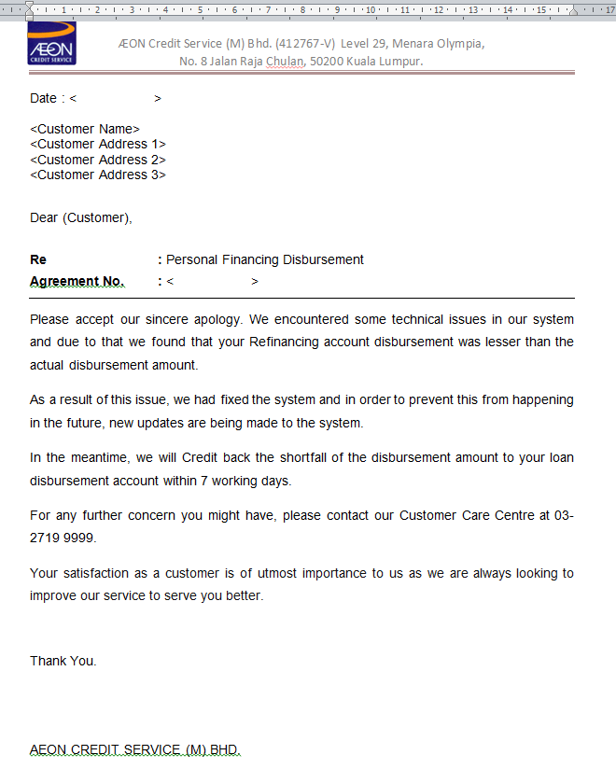
PF Refinancing Disbursement Issue
Appendix
Letter to notify customers

Slide 12
PF Refinancing Disbursement Issue
Appendix
Account Status | Count | Expected TT Amount (RM) | Actual TT Amount (RM) | Variance (RM) |  | Remarks
1st Instalment on Sep 2, 2017
Active | 130 | 1,056,741.18 | 1,050,849.26 | 5,891.92 | Disbursed Less
Active | 16 | 132,092.63 | 132,103.42 | (10.79) | Disbursed More
Early Settled | 1 | 6,273.05 | 6,272.80 | 0.25 | Disbursed Less
1st Instalment on Oct 2, 2017
Active | 645 | 4,876,091.54 | 4,847,765.43 | 28,326.11 | Disbursed Less
Active | 87 | 734,136.54 | 734,190.54 | (54.00) | Disbursed More
Early Settled | 1 | 15,637.93 | 15,631.00 | 6.93 | Disbursed Less
1st Instalment on Nov 2, 2017
Active | 793 | 6,105,993.59 | 6,070,638.96 | 35,354.63 | Disbursed Less
Active | 94 | 681,572.24 | 681,626.72 | (54.48) | Disbursed More
Early Settled | 1 | 20,441.08 | 20,440.00 | 1.08 | Disbursed Less

Slide 13
PF Refinancing Disbursement Issue
Appendix
Account Status | Count |  | Expected TT Amount (RM) | Actual TT Amount (RM) | Variance (RM) | Remarks
1st Instalment on Dec 2, 2017
This Month Sales | 144 |  | 1,073,190.18 | 1,067,226.63 | 5,963.55 | Disbursed More
This Month Sales | 16 |  | 128,340.62 | 128,377.71 | (37.09) | Disbursed Less
This Month Sales | 1 |  | 3,252.44 | 1,510.56 | 1,741.88 | Manual Disbursement - successful
TOTAL – By Remarks
Disbursed More |  | 1,715 | 13,154,368.55 | 13,078,824.08 | 75,544.47 | -
Disbursed Less |  | 213 | 1,676,142.03 | 1,676,298.39 | (156.36) | -
Manual disbursement - successful |  | 1 | 3,252.44 | 1,510.56 | 1,741.88 | -
Total |  | 1,929 | 14,833,763.02 | 14,756,633.03 | 77,129.99 | -

Slide 14
End

